Slide 1




Modeling the Stats and Salaries of the NFL, NBA, and NHL
Ryan Stevens and Alex Olteanu

Slide 2
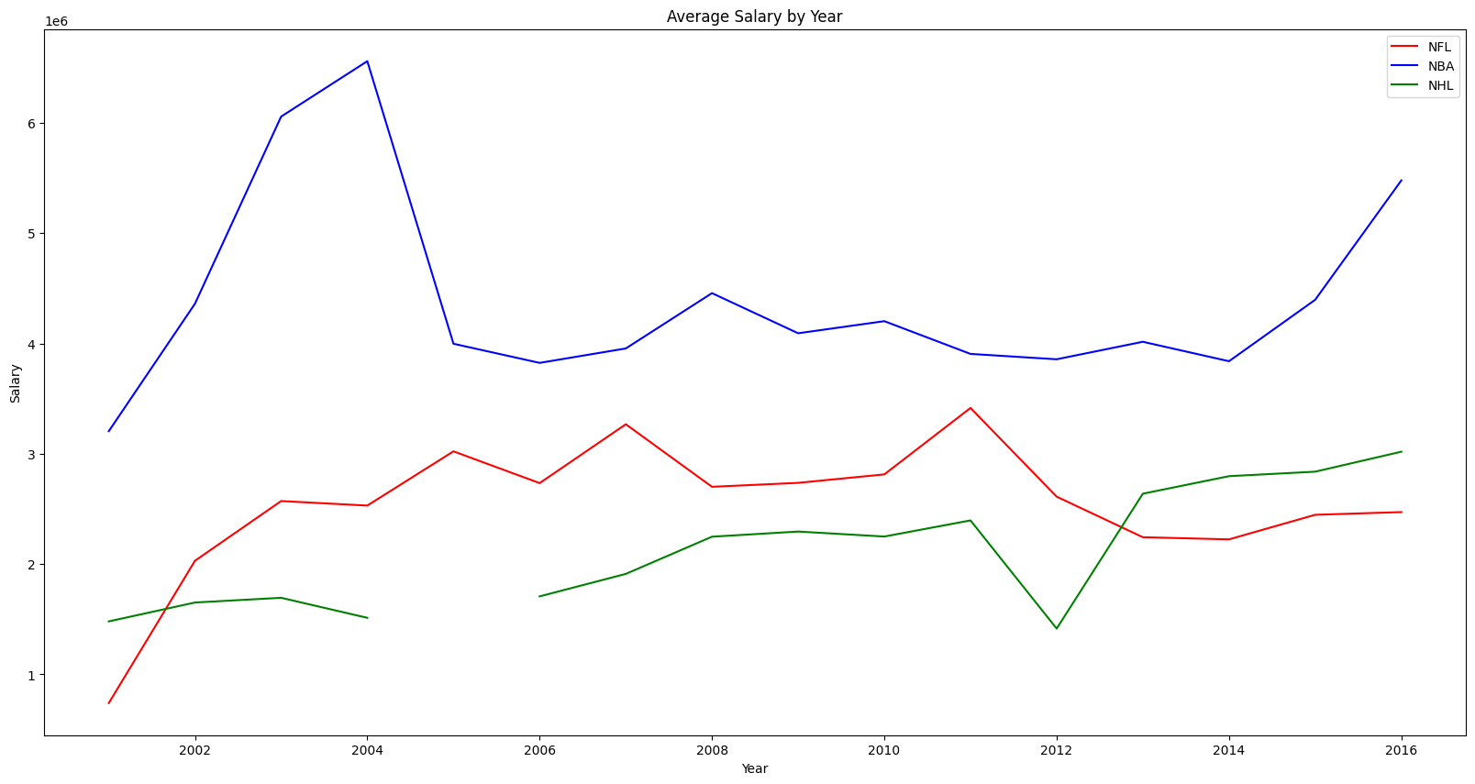
Goal & Motivation
Goal
Find correlations between professional athlete’s stats and salaries
Use correlations to predict future salaries
Use correlations to predict future performance/stats
Motivation
We wanted to create models that can predict professional athlete’s future salaries or stats/performances
Want to use this data to predict future team performances based on those models and models of team performance
Hypothesis
If a player has more goals, points, or touchdowns, then they will have a higher salary
If a player has a higher salary then they should have a higher performance rating

Slide 4
Data we used
NHL
Stats - http://inalitic.com/datasets/nhl%20player%20data.html
Salary – Web Scraped https://www.hockeyzoneplus.com
NFL
Stats - https://www.kaggle.com/datasets/kendallgillies/nflstatistics?resource=download
Salary – Web Scraped https://overthecap.com
NBA
Stats - https://www.kaggle.com/datasets/drgilermo/nba-players-stats?select=player_data.csv
Salary - https://github.com/erikgregorywebb/datasets/blob/master/nba-salaries.csv

Slide 5
Extract, Transform, And Load (ETL)

Slide 6
Cleaning the Datasets
NHL | NFL | NBA
Goalie and skater stats had some repeating values Removed some unused bad columns | Each different stat csv had many values Removed all unused data Convert values from strings to floats | Removed some unneeded stats Removed unnecessary or unused stats

Slide 7
Merging the stats and salary data for each league
NHL
We had to merge goalie stats and skater stats at first, then we could merge it with our salary dataset from the web scraper
NFL
We had to merge multiple different stat csv’s into one dataset, then we could merge it with our salary dataset from the web scraper
NBA
Easiest merge, just one stats dataset and a salary dataset

Slide 8
Dealing with missing data after merges
After finding that some data was missing after the merge processes, we looked to see why it was missing
Found that most of the missing data was due to that stat not being tracked until a certain date
Choose to remove years until important stats were tracked like Points, Goals, or Touchdowns
For less important stats we choose to replace null values with the columns mean or average.

Slide 9
Exploratory Data Analysis (EDA)

Slide 10
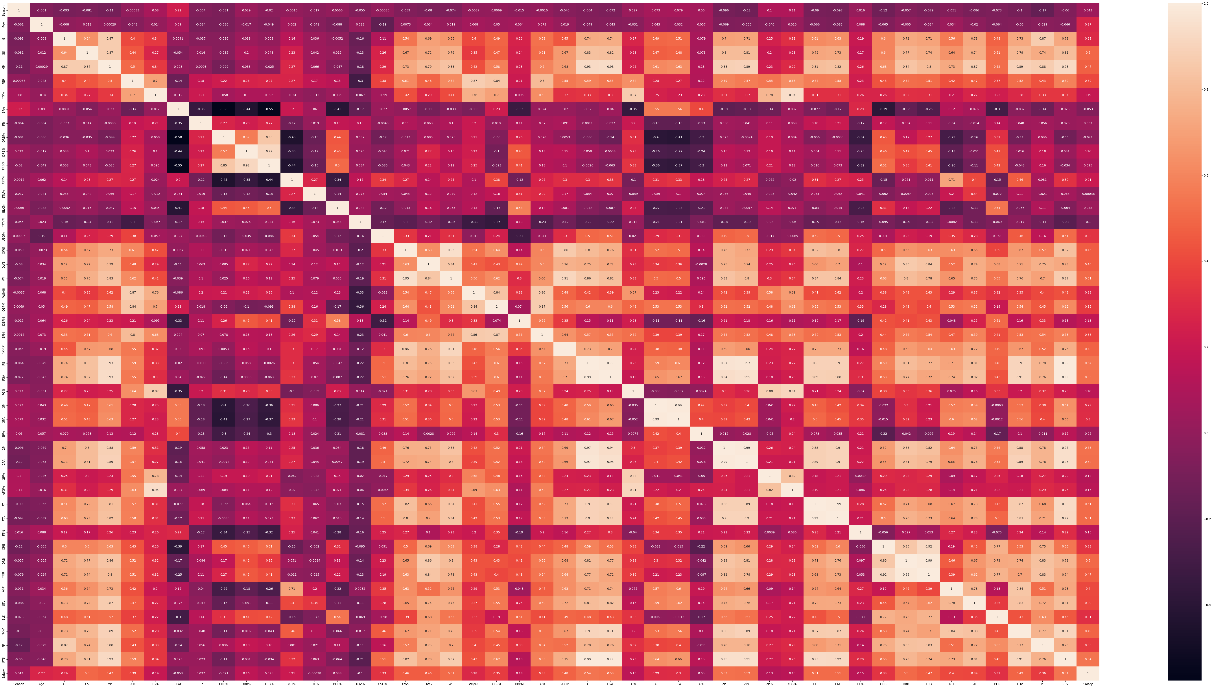
Correlation and scatter plot Matrices
We found correlations for salary in multiple stats for each league using correlation and scatter plot matrices
NHL
G, GPG, A, GS%
NFL
TDs, Average passing yards per game, Average rushing yards per game, Average receiving yards per game
NBA
GS, WS, FG, FGA, 2P, 2PA, FT, FTA, DRB, PTS

Slide 11
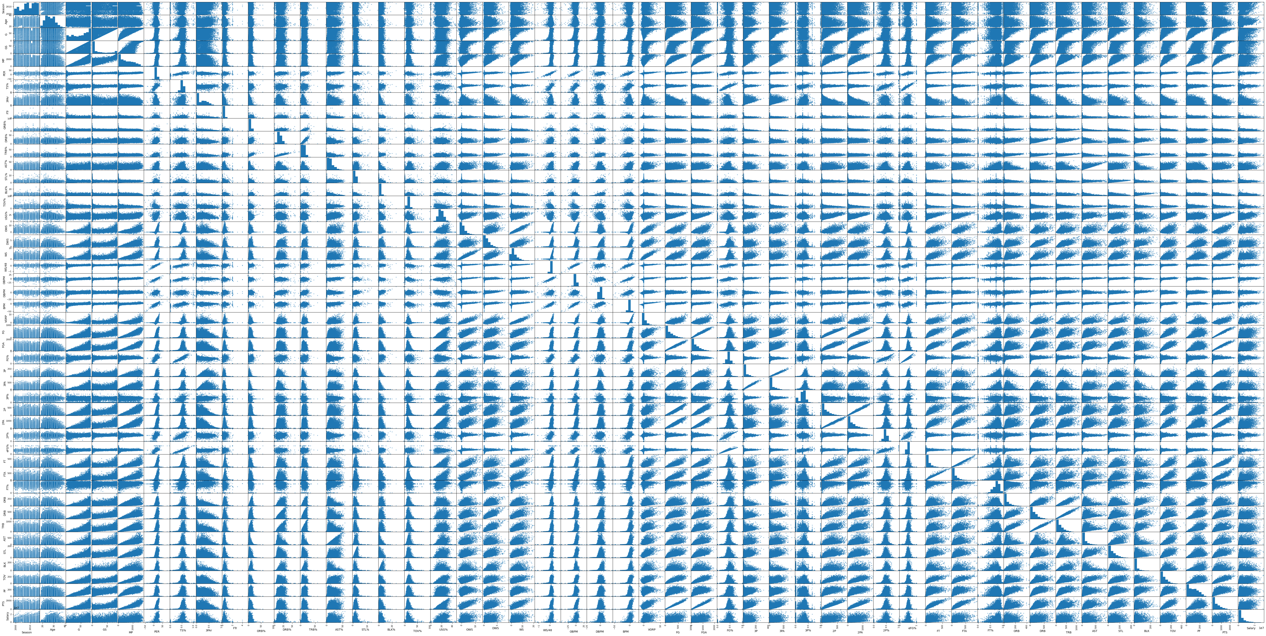

Slide 12
KNN Model for predicting salary
We are looking to use the correlations we found and create a model that uses them to predict a player’s future salary
For each league we will need to choose what stats to include in the prediction

Slide 13
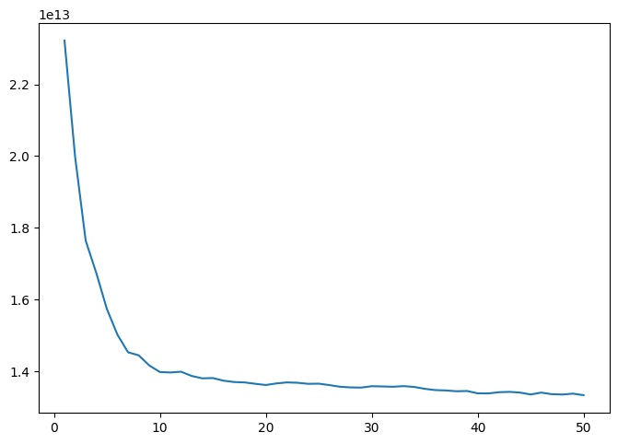
Conclusion
We have found some predictive stats using our data like Goals or PTS in the NHL and NBA respectively
Looking to try and predict future stats for our second model
We will probably need to normalize all stats for each league into one performance stat

